Slide 1
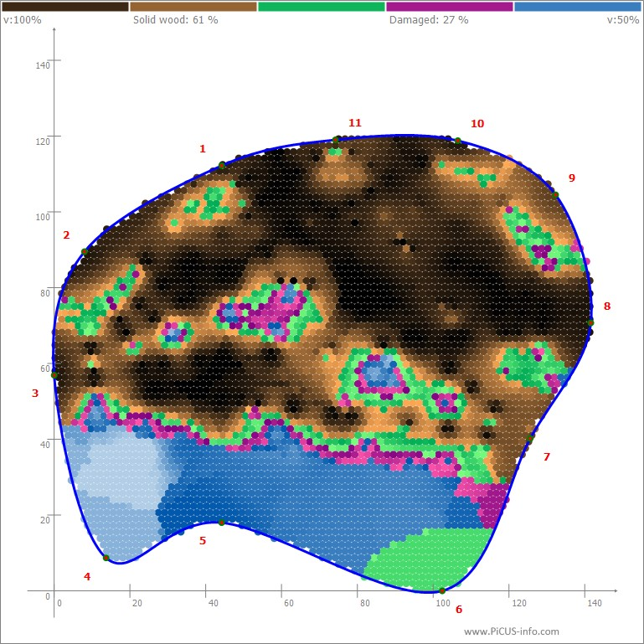
F-76A

Slide 2
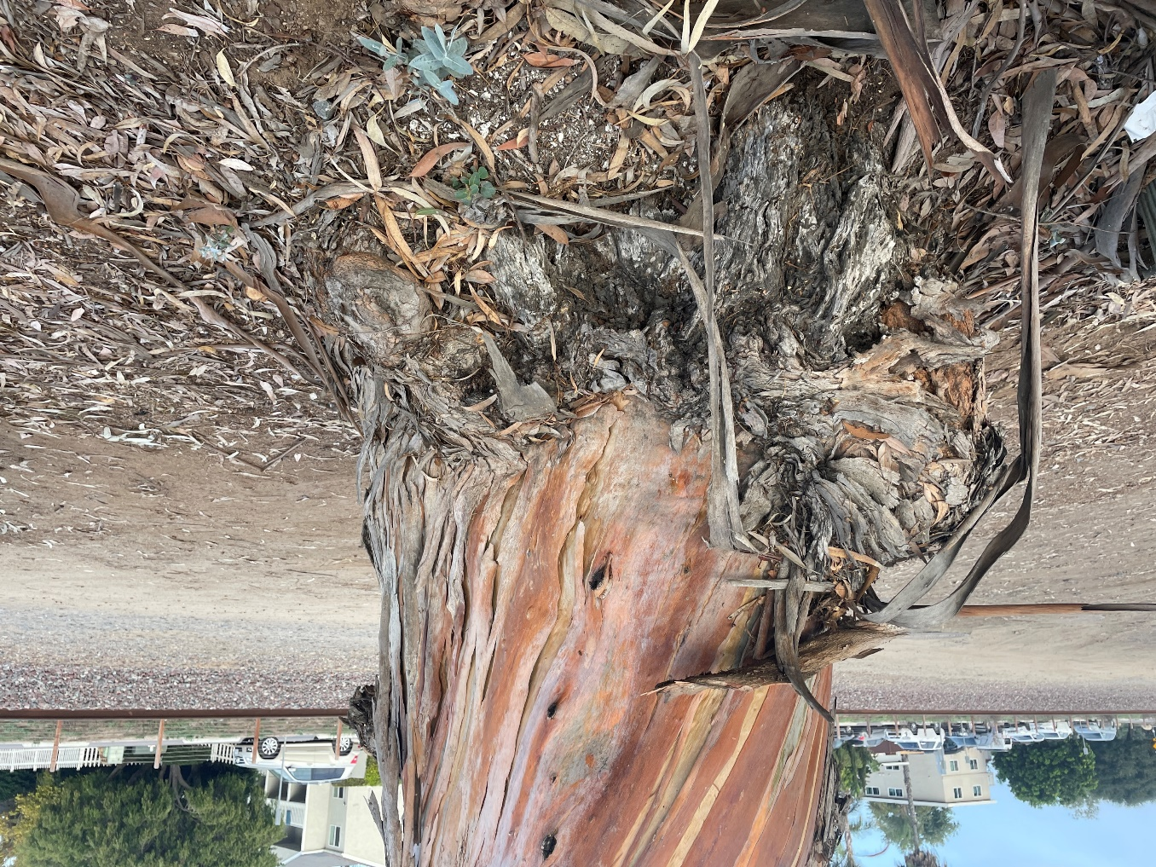
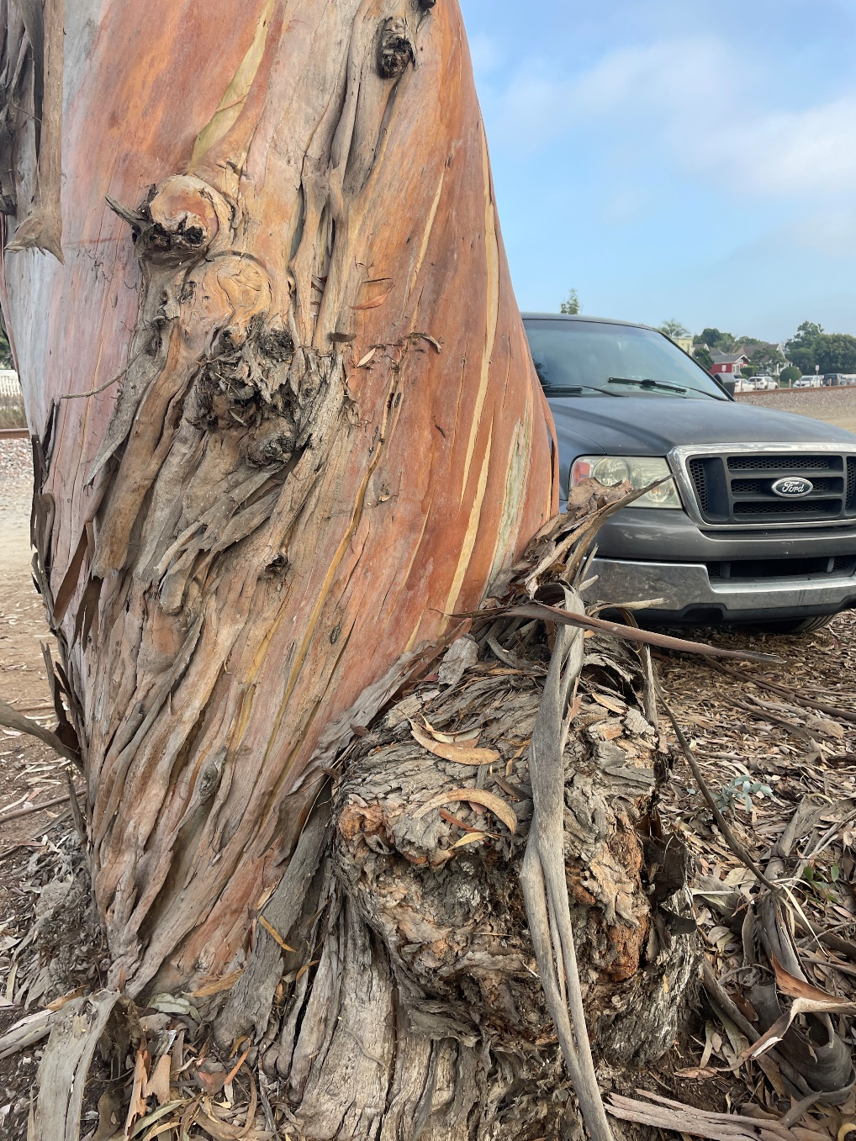
Burl on west side of trunk of Tree F-76
Burl on west side of trunk of Tree F-76

Slide 3
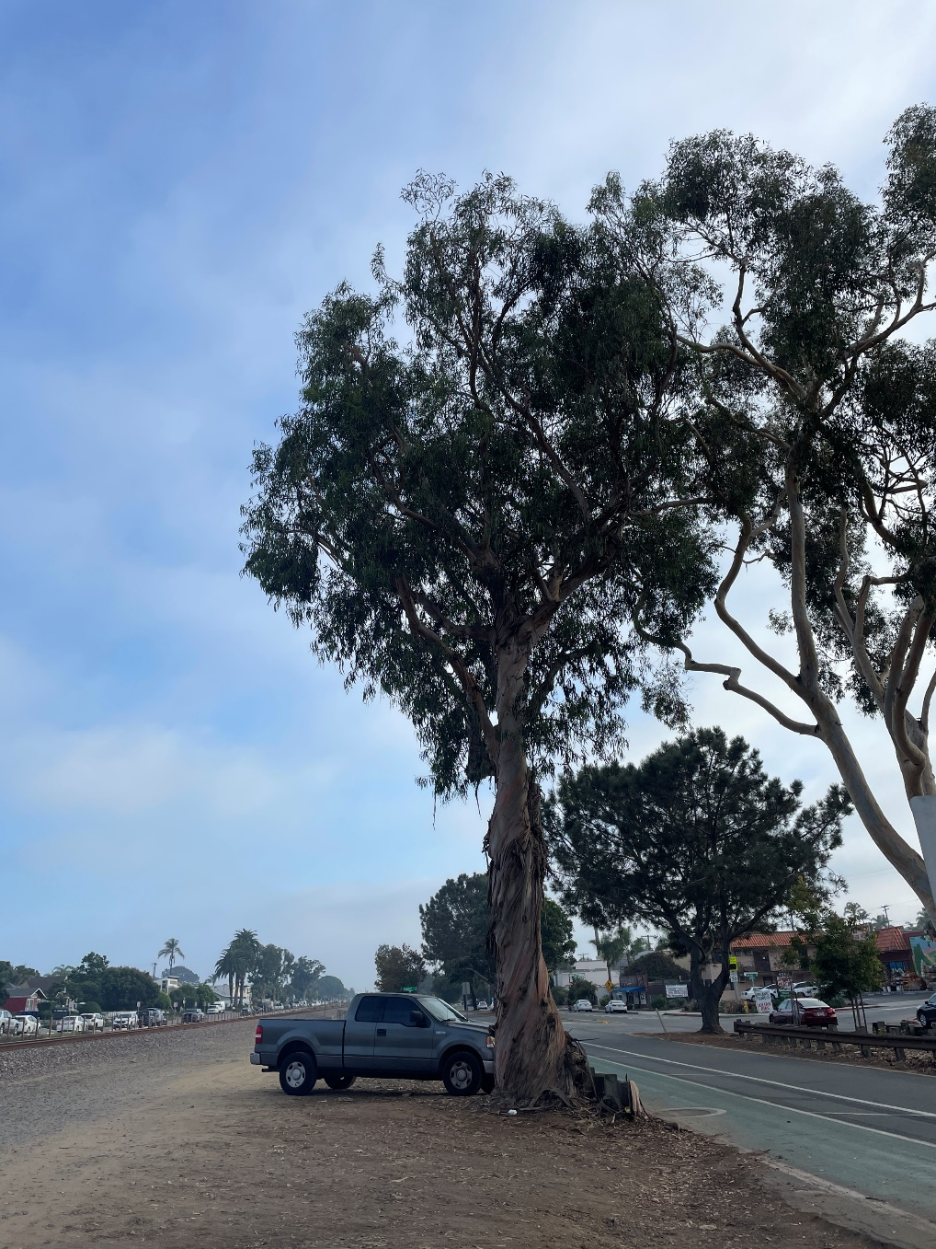
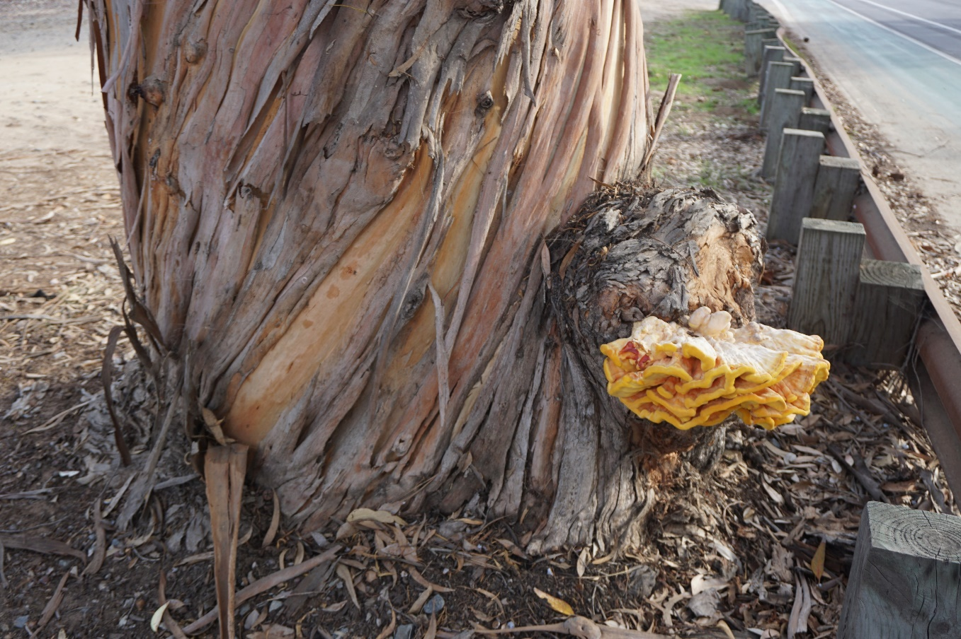
Sulfur fungus fruiting body on burl on trunk of Tree F-76
Overview of Tree F-76

Slide 4
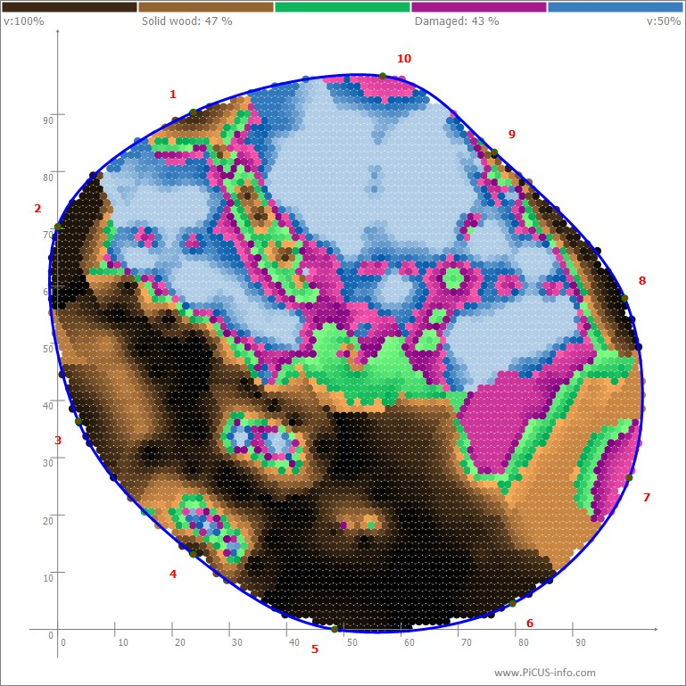
20544A

Slide 5
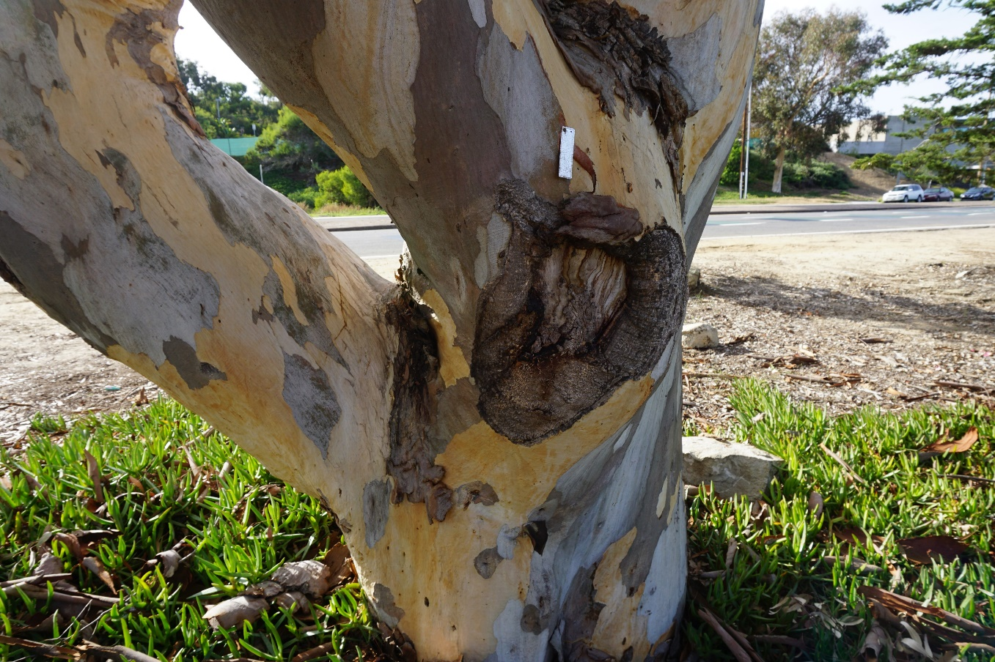
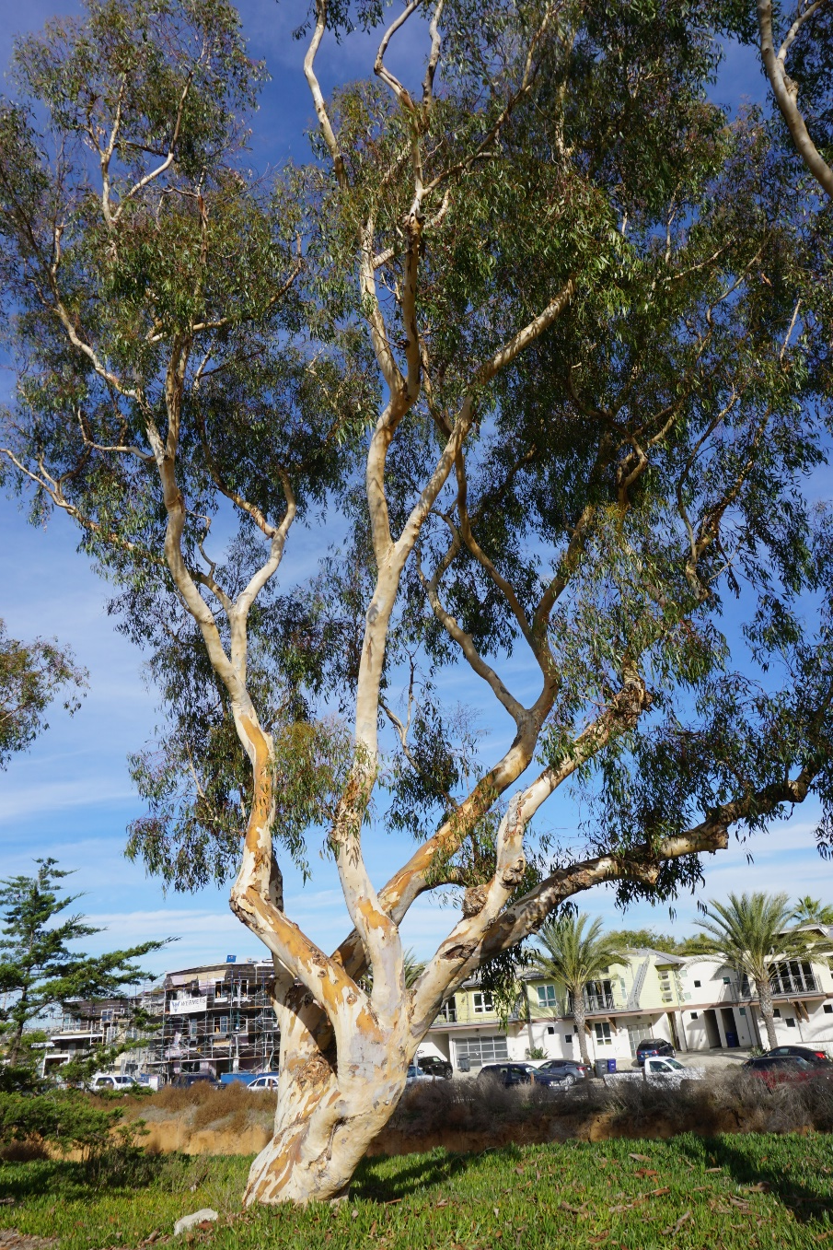
20544PWTree – Wound on east side of tree
20544PWTREE – Overview

Slide 6
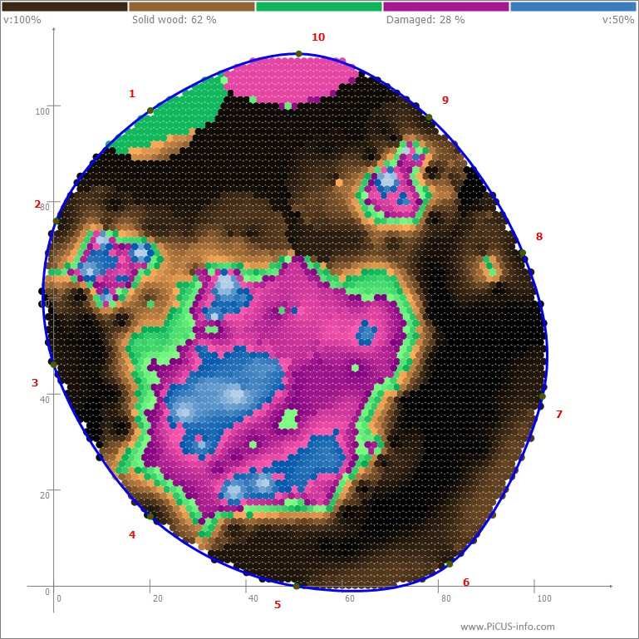
20531A

Slide 7
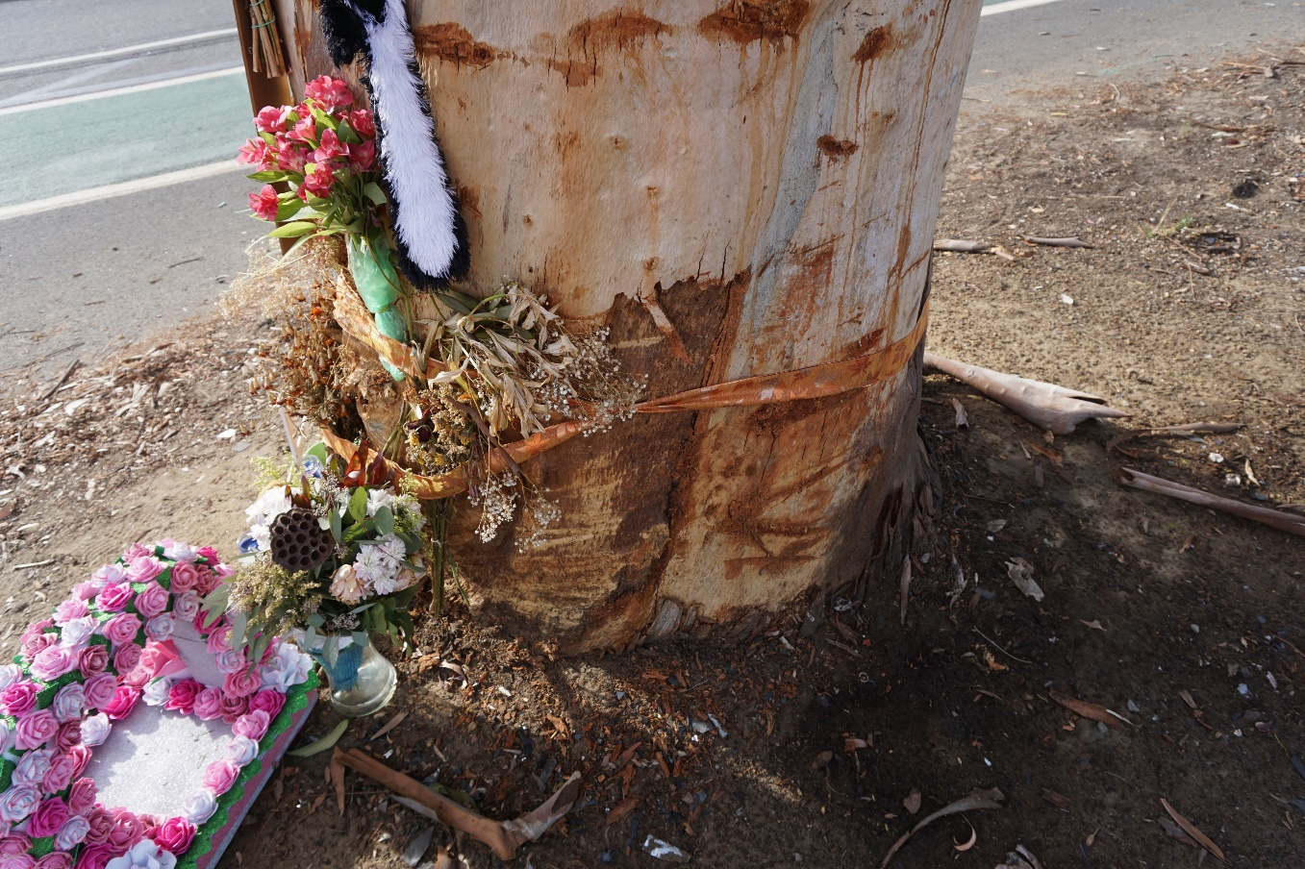
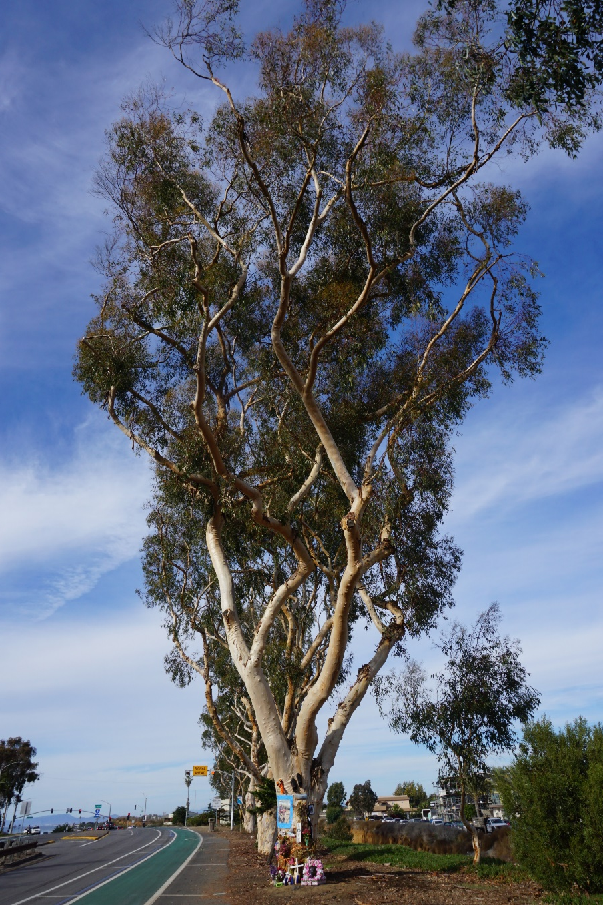
View of recent large basal wound on trunk of Tree 20531
20531PWTREE – Overview

Slide 8
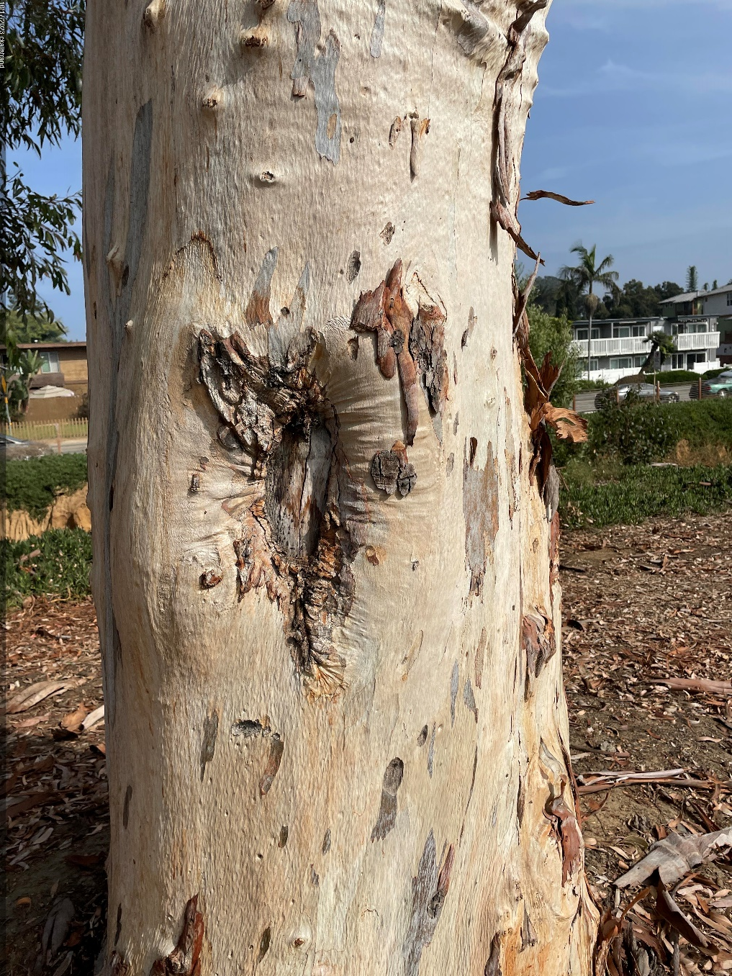
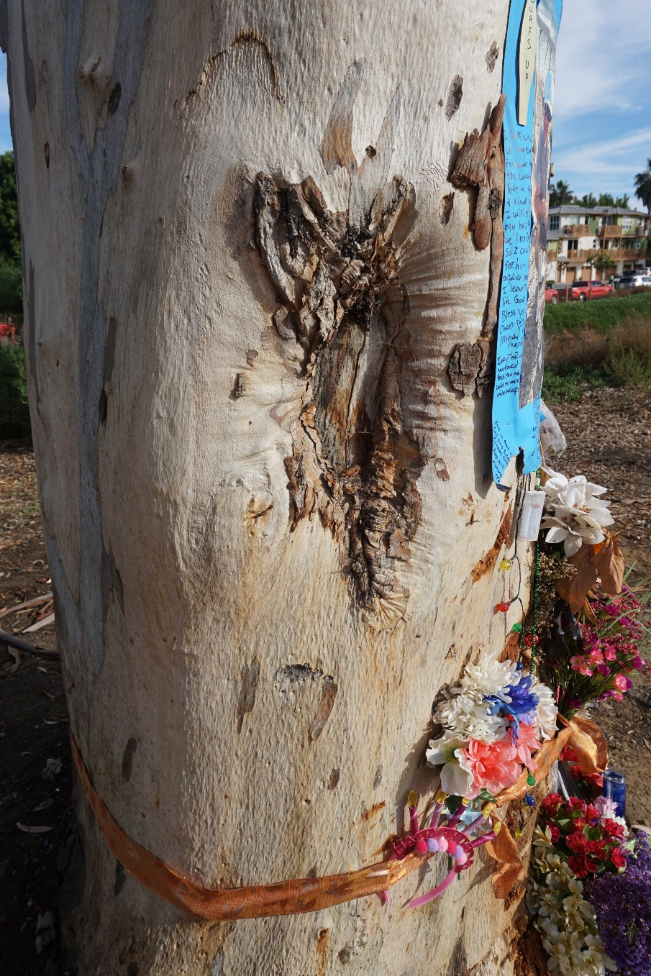
View of wounds on trunk of Tree 20531
View of wounds on trunk of Tree 20531

Slide 9
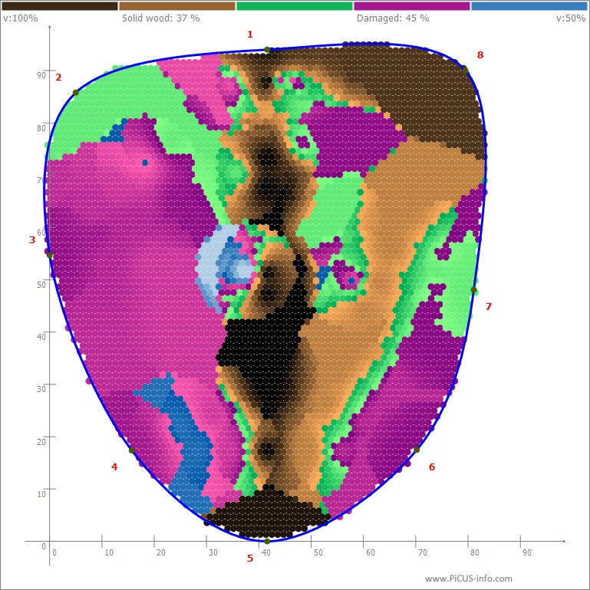
20506A

Slide 10
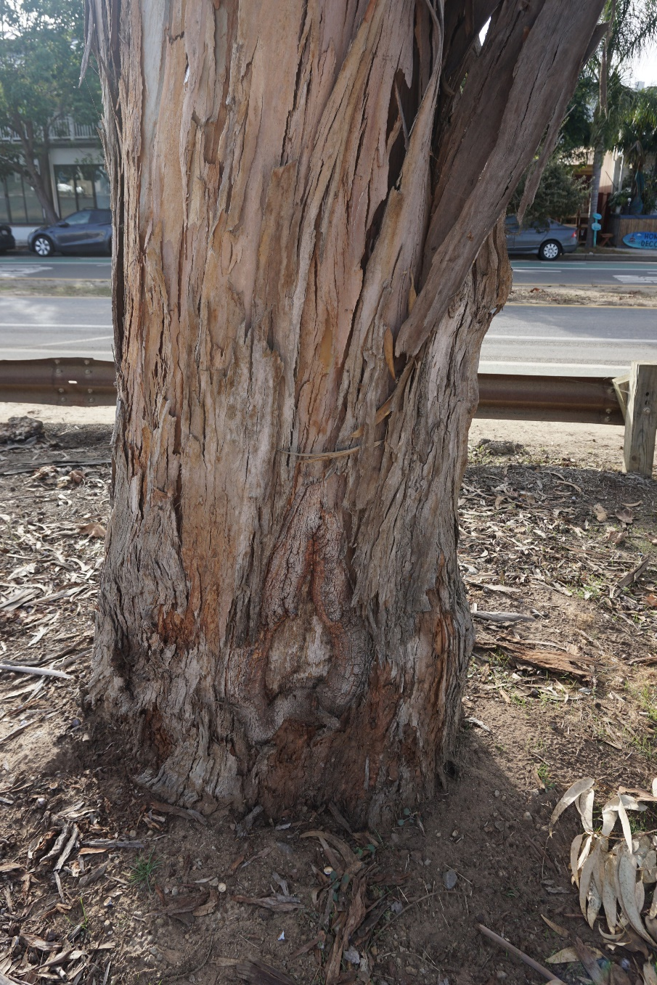
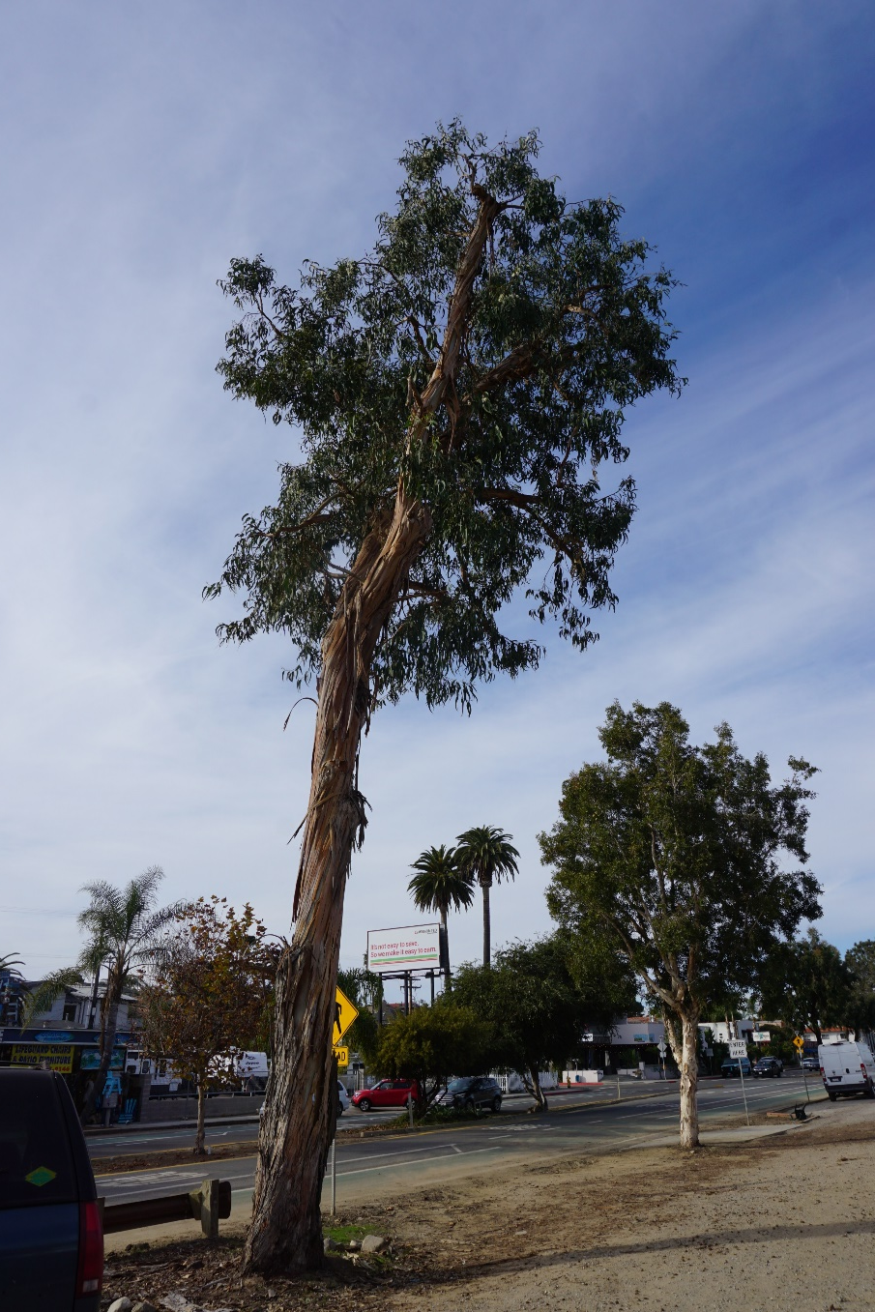
View of wounds on trunk of Tree 20506
20506PWTREE – Overview

Slide 11
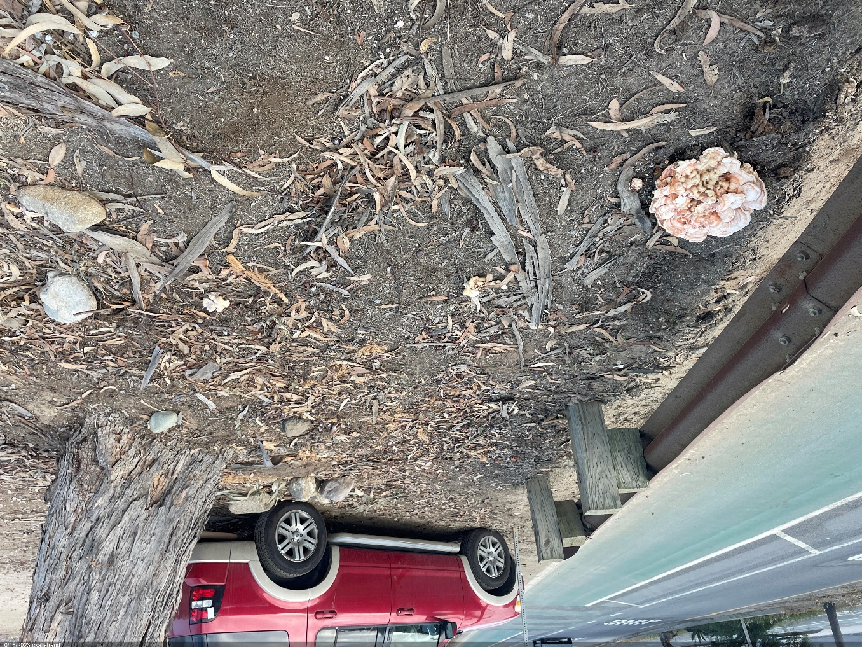
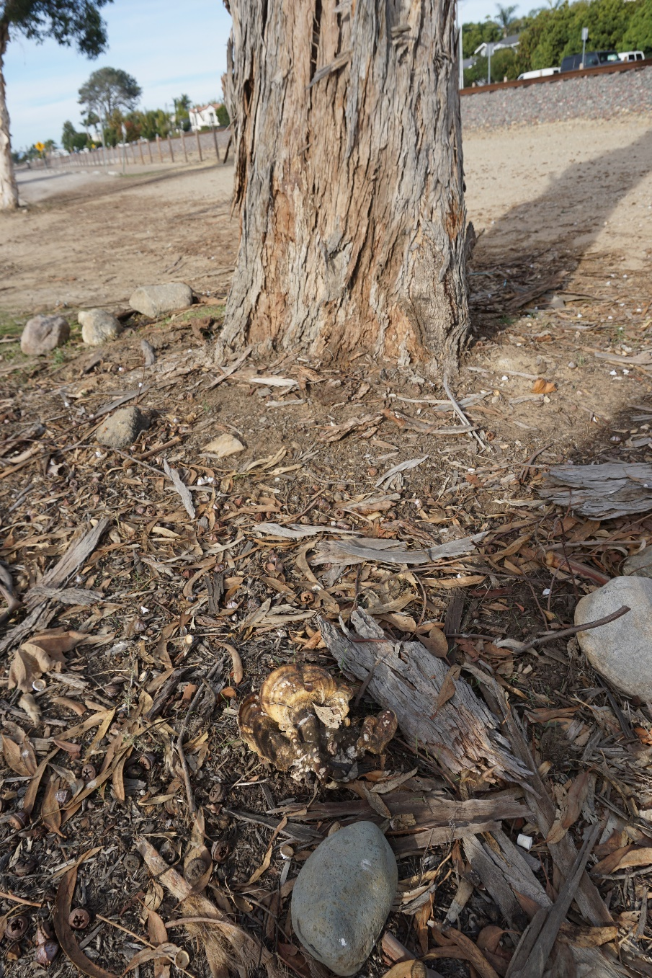
View of sulfur fungus fruiting bodies on structural roots of Tree 20506
View of sulfur fungus fruiting body on structural roots of Tree 20506

